Slide 1
SUST_Newbie
Bhashamul: Bengali Regional IPA Transcription
S
F
Farzine Hossen
Siam Arefin
Venus is extremely hot, even more than Mercury
S
Sawon
Earth is the third planet from the Sun

Slide 2

Methodology: Dataset → Model → Parameter
Dataset cleaning:
Remove punctuation and Bangla numerical, English alphanumeric value
Try OOV handling:
Manually annotate about 9000 words from Bangla to IPA website
Add susmitIPAData.csv file
Add Dataverse Challenge – ITVerse 2023 training dataset

Slide 3
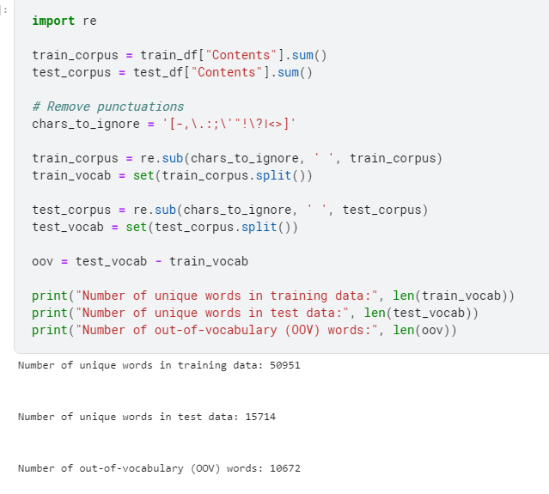

Slide 4
MODEL
EVALUATION
byt5-small
byt5-base
mt5-small
mt5-base
score
score
score
score
0.304
0.35
0.48
0.31
Try other models:
t5, banglat5, banglabert, encoder-decoder transformer model

Slide 5
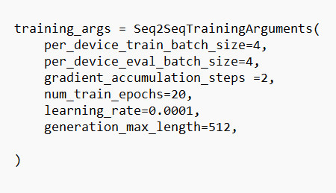
byt5-base
Score: 0.045

Slide 6


Thank You

